Slide 1
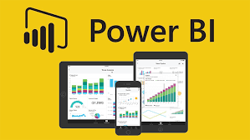
What is Power BI?
Microsoft Power BI is a collection of software services, apps, and connectors that work together to turn your unrelated sources of data into coherent, visually immersive, and interactive insights. Whether your data is a simple Microsoft Excel workbook, or a collection of cloud-based and on-premises hybrid data warehouses.
Power BI lets you easily connect to your data sources, visualize (or discover) what's important, and share that with anyone or everyone you want.

Slide 2
Tasks done by Power BI

Slide 3
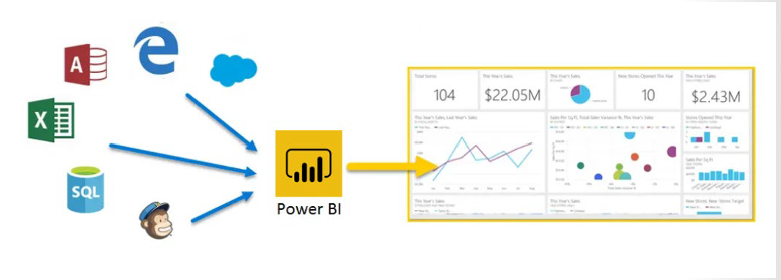
How Power BI Works?

Slide 4
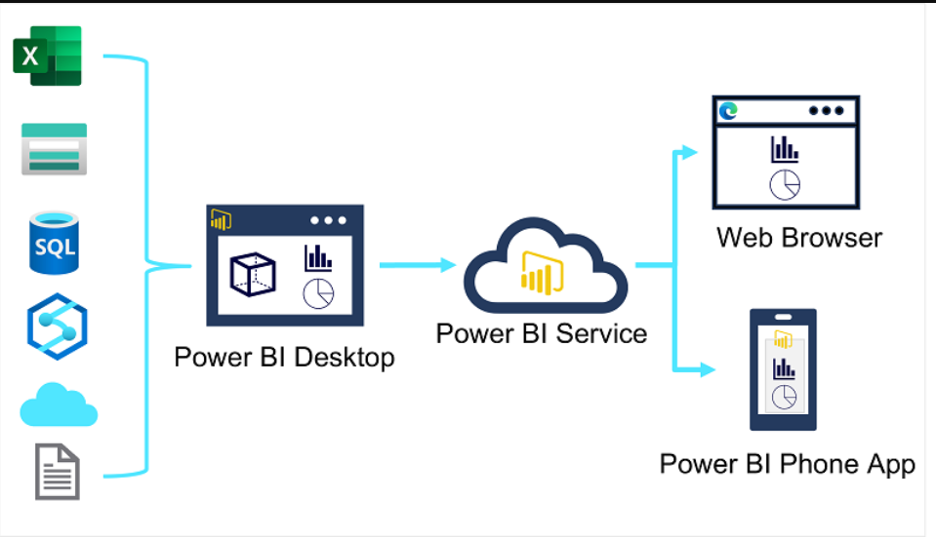
How Power BI Works?

Slide 5
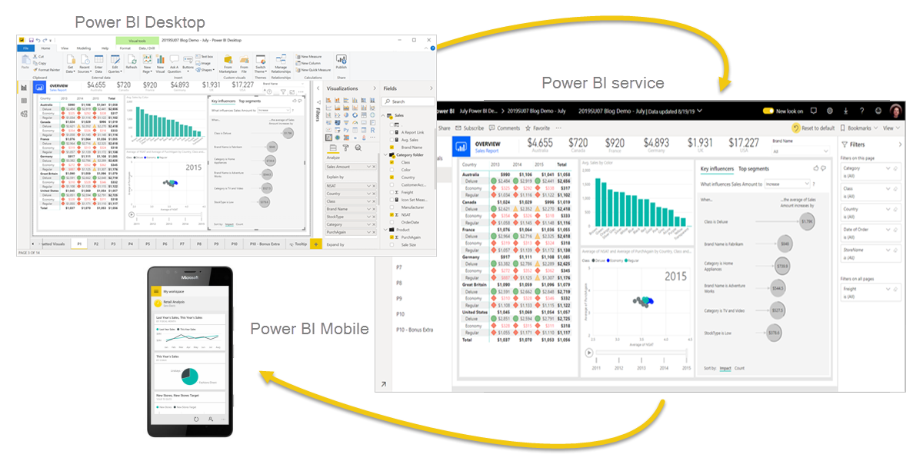

Slide 6
Roles in Data

Slide 7
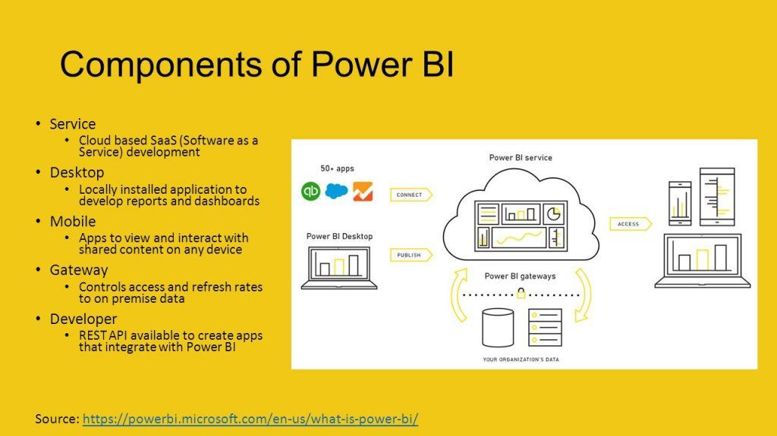

Slide 8
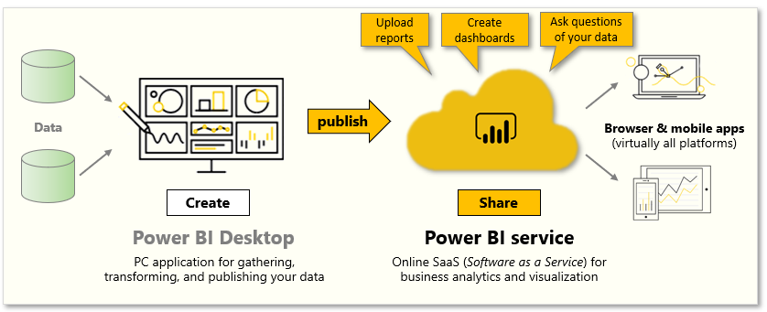
Components of Power BI

Slide 9
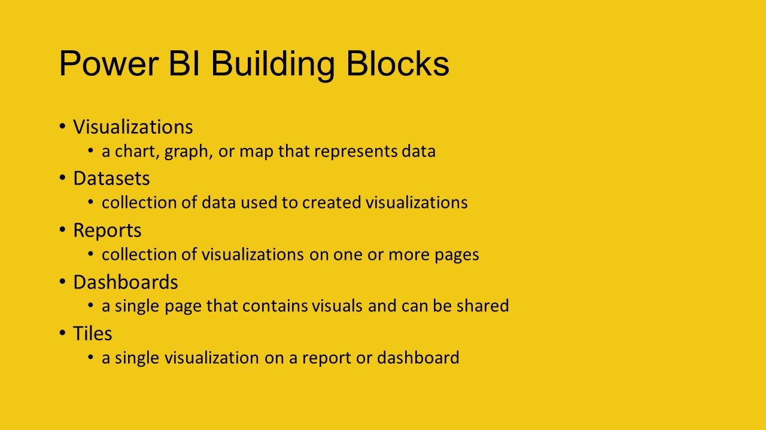

Slide 10
